Slide 1




Fake Medicine Detection
in South Africa
A Graph-Based Image Processing Approach
Cornerstone Coders
CSC Mini Project

Slide 2



Meet the Team: Cornerstone Coders
Technical Foundations
A group of four passionate computer scientists collaborating on a real-world health challenge in the South African context.
O Ntebe 222033549
N Dube 223080564
MJ Makhavhu 223042963
TM Mphahlele 223164048

Slide 3
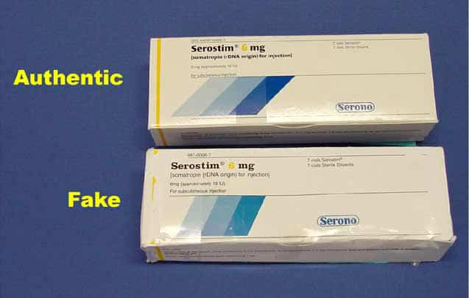
Project Background
South Africa faces a growing counterfeit medicine crisis, impacting thousands annually.
Counterfeits range from essential antibiotics, syrups, and even life-critical medications.
Consumers depend on manual inspection, which can be hard to notice subtle changes in medicine packaging.
Source Case Studies:
- Surge in Cases: A 5-fold increase in SAHPRA whistle-blower tip-offs regarding fake products since 2021
- Devastating Human Toll: Over 120,000 children under five die annually in sub-Saharan Africa due to fake anti-malarial drugs alone

Slide 4
The Core Problem
Counterfeit medicines put lives at risk daily
Human eyes cannot detect subtle variations such as color shade, texture, printing quality in counterfeit manufacturing.
±30%
Existing solutions are:
MEDICAL PRODUCTS FALSIFIED IN AFRICA
Expensive
Require constant internet
Not tailored for South African market
Critical Question: How can we accurately verify medicine authenticity using only an image taken by a normal camera?

Slide 5
Project Objectives
Main Objective
Develop a standalone Java Desktop Application for detecting fake medicines by analyzing images of pills and packaging.
Convert images into graph structures.
Implement similarity detection.
Extract features via color histograms.
Implement Image classification (Authentic vs Fake).
Project built on efficient data structures, and algorithms.
User-friendly desktop interface.

Slide 6

The Methodology
Graph-Based Detection

Slide 7
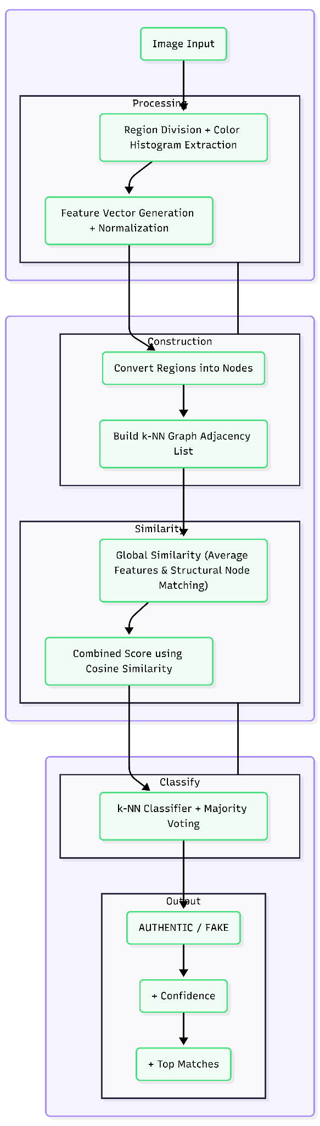
System Architecture Pipeline
Data Flow
1. Input: Raw medicine image (pill or package).
2. Image Processing: Color Histogram and Feature Extractor.
3. Logic: Graph construction (Image To Graph, CRUD).
4. Algorithms: Similarity Detection engine.
5. Output: Final classification and Confidence score.

Slide 8


Image Processing Module
Grid-Based Feature Extraction
The image is divided into a grid to make regions enabling the capturing of color histograms.
L2 Normalization ensures robust feature comparison.

Slide 9


Graph Construction
Structural Representation
Each grid cell is treated as a Node. We establish connections using k-Nearest Neighbors (k-NN) to build a visual graph.
This graph representation preserves each nodes color feature vector, which is vital for detecting subtle packaging shifts.
Graph includes CRUD functionality, demonstrations of shortest path and an MST construction
Class: ImageToGraph
Structure: Custom Adjacency List

Slide 10




Similarity & Classification
Similarity Detection
K-NN Classifier
Calculates the visual distance between two graphs using Cosine Similarity combined with Node-to-Node matching.
Find K number of similar images throughout the entire dataset, and use voting to determine if the product is AUTHENTIC or FAKE
Returns a Confidence Score and a list of top matching medicines which are classified and scored for similarity.

Slide 11
Data Structures
Data Structure | Implementation Detail | Application in Project
Adjacency List | Linked Nodes & Edges | Core Graph storage for image segments.
HashMap | Custom Hash Hashing | Fast lookup of medicine objects.
Heap (Priority Queue) | Min Binary Heap | Retrieving shortest paths
LinkedList / Stack | Dynamic Sizing | Managing image nodes and edges, enabling CRUD functionality

Slide 12
App Demonstration
Fake Medicine Detector

Slide 13
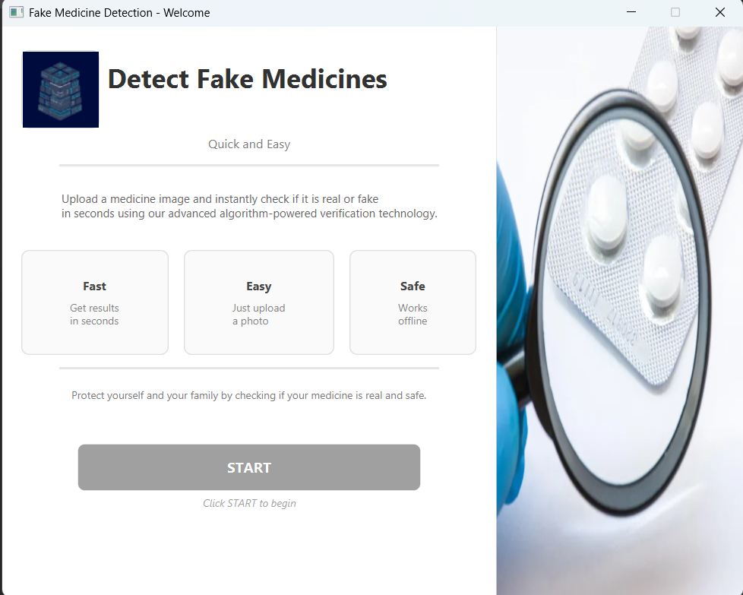
App Intro Page
Fake Medicine Detector

Slide 14
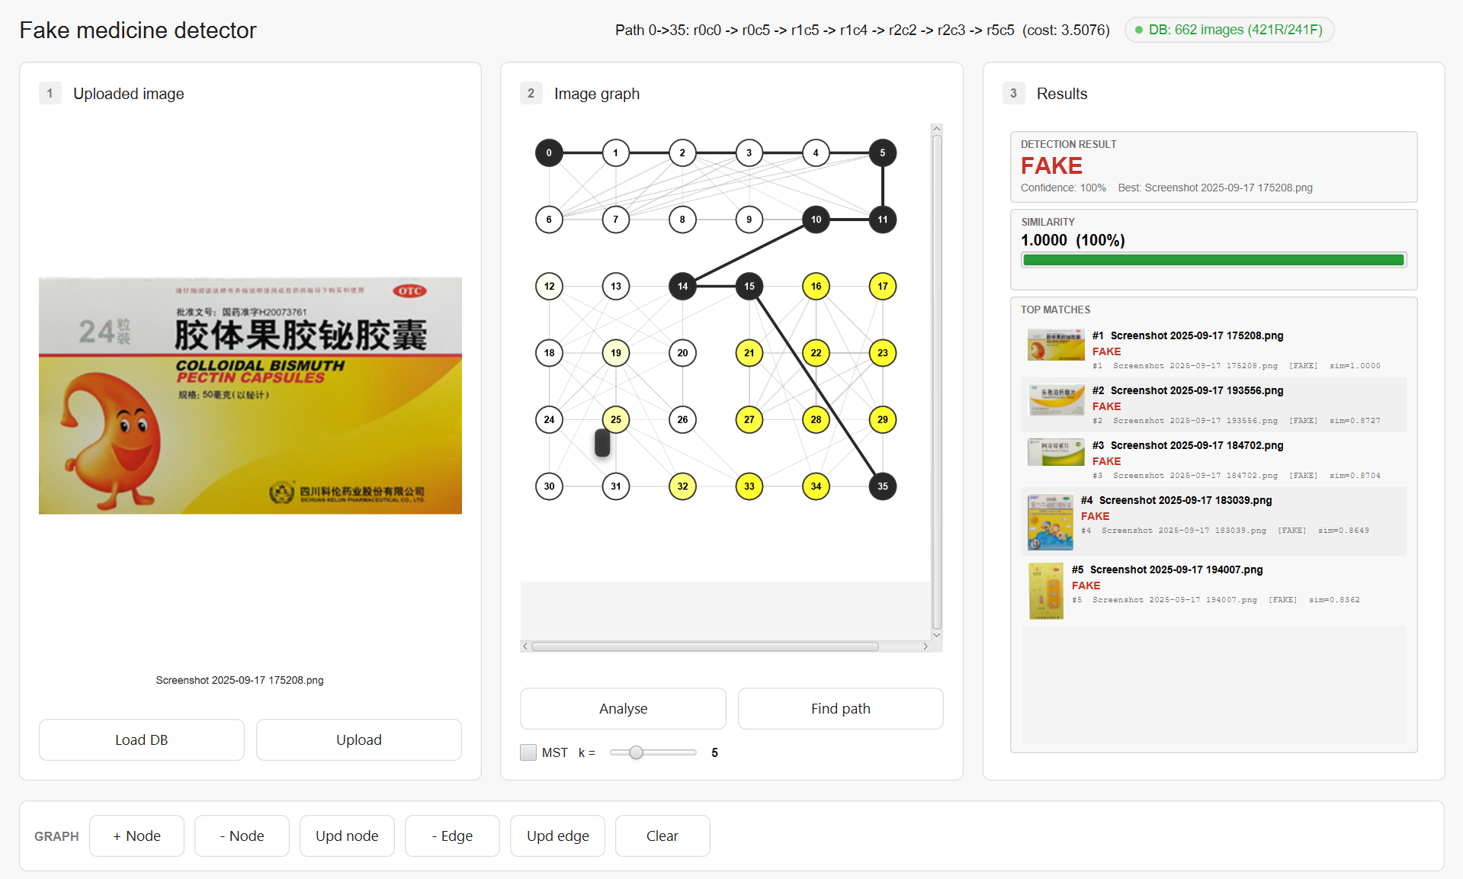
App Process Workflow Page
Fake Medicine Detector

Slide 15

Conclusion
Successfully developed a graph-based fake medicine detection system that delivers a practical solution to a South African health crisis.
Our system proves that by combining foundational data structures, graph logic, and image processing, we can build robust, capable tools that safeguard public health.

Slide 16
Thank You
Cornerstone Coders

Slide 17
Project Sources
https://www.ispor.org/docs/default-source/presentations/873.pdf?sfvrsn=88b82b3b_1
https://www.medicalbrief.co.za/sa-launches-who-backed-plan-to-combat-rise-of-counterfeit-meds/
https://fiveable.me/data-structures/unit-10/graph-adt-basic-operations/study-guide/vWOgZLIBmamAdk6X
https://medium.com/@steoamon/understanding-graph-operations-an-example-using-an-adjacency-matrix-be5adb4665a9
https://www.researchgate.net/publication/350818425_k-Nearest_Neighbor_Learning_with_Graph_Neural_Networks
https://www.cs.princeton.edu/cass/papers/www11.pdf
https://www.sciencedirect.com/science/chapter/monograph/abs/pii/B9780128238172000115
https://erepo.uef.fi/server/api/core/bitstreams/f70009b5-2a47-4070-81d1-392019cd23d1/content#:~:text=Trivial%20brute%20force%20algorithm%20constructs,over%20the%20brute%20force%20method
https://www.youtube.com/watch?v=lv8-YgWYtU4
https://garagefarm.net/blog/color-histograms-demystified-from-theory-to-practical-image-analysis
https://www.sciencedirect.com/topics/computer-science/color-histogram
https://youtu.be/AzSJ6v4u-t8?si=RCYOqlYfQily_KBm
https://www.geeksforgeeks.org/dbms/cosine-similarity/
https://www.geeksforgeeks.org/machine-learning/l1-l2-norms-in-sparse-modeling/
https://youtu.be/pLIajuc31qk?si=zlFvDnqp1uE3QIzz
https://youtube.com/shorts/XuZCJ5eeZf8?si=OvRX26Ub5hS-SQWV

